Slide 1



Virtual scavenger hunt

Slide 2
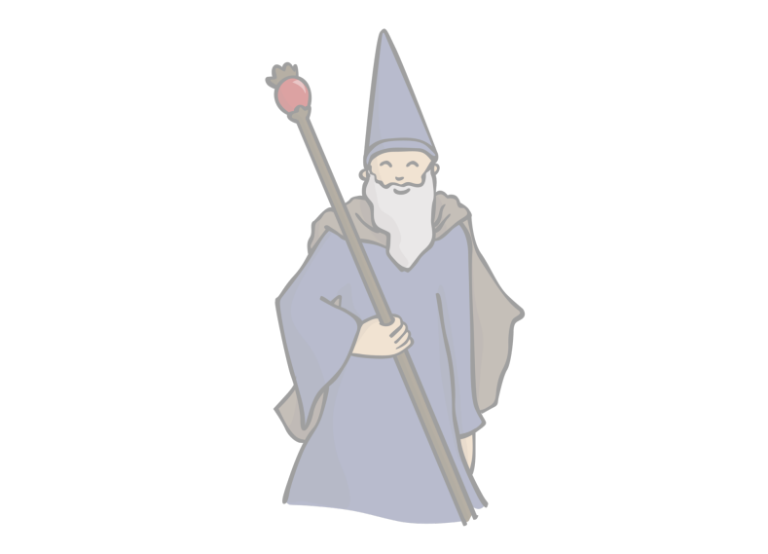
HOGWARTS ESCAPE ROOM
Enter the escape room if you dare, many have tried but their maths just weren’t good enough.
PTPL Virtual Escape Rooms (google.com)

Slide 3
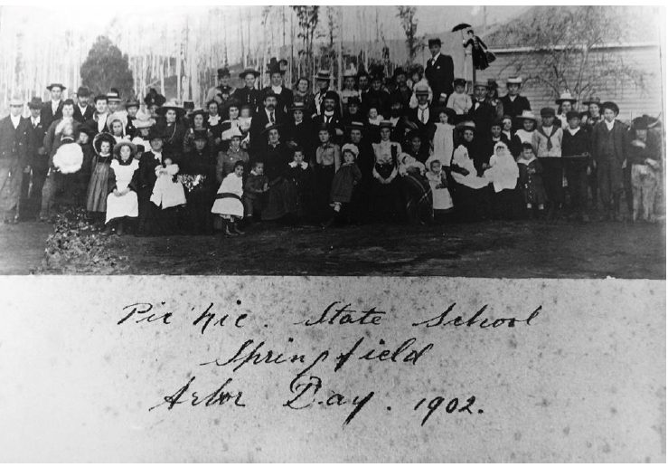
Mary Poppins is poppin in, can you find her?

Slide 4
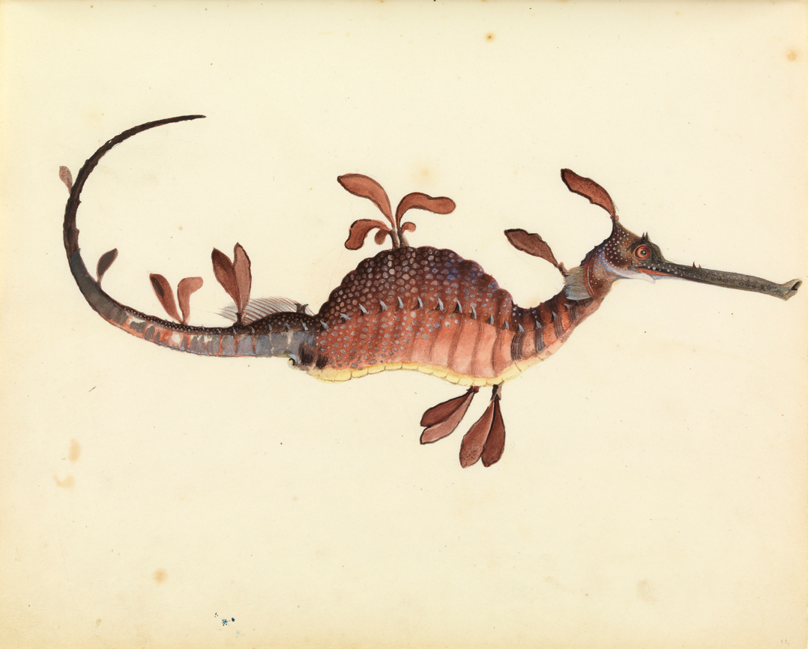

That Celebrated & Eccentric Genius, Gould
Can be found on the Libraries Tasmania website and viewed as an eBook.
In the book ‘That Celebrated & Eccentric Genius, Gould’ how many people are in the Tread Wheel painting?
There are some really great crafts to have a crack at,
we took on the challenge of making a digital book. We installed the Book Creator app
You can view our story next. It’s based on a true story with a little bit of whimsy at the end.

Slide 5
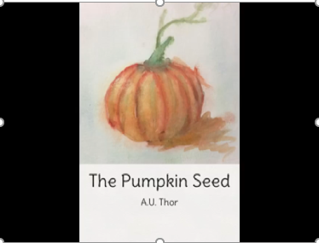
The Pumpkin Seed
https://www.youtube.com/watch?v=iSg9VtRhAQM&list=PL7sN-HNFM2CKfiLsNlf6JBAq1Y4vjrG3L&index=34

Slide 6
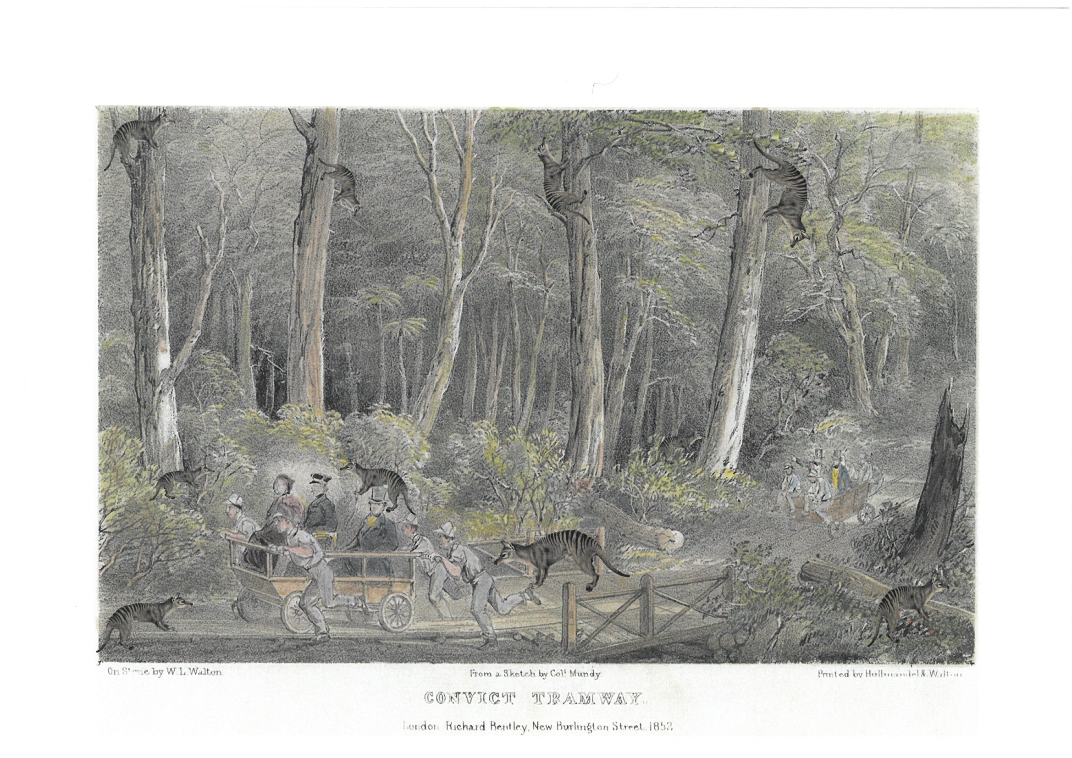
How many Thylacines?

Slide 7
TASKMASTER FOR KIDS
(or if you swap the T and the M it becomes MASKTASTER...YUM!)
We(the staff at the Launceston Library)looooove TASKMASTER, in fact we love it soooooooo much we made our own show ☺.
Have you seen any episodes? (you might not be allowed, there are some naughty words used).
We would like to set you some challenges (it’s called home tasking). You could film them and send them to us or hashtag Launceston Library online.
(Here are some real examples from the TM YouTube Channel Camouflage Yourself, Then Reveal Yourself | #HomeTasking #StayHome – YouTube )
Here are some tasks that we’d like to set you:
Paint a picture – blindfolded
Take an impressive photograph
Throw a tea bag into a mug from the furthest distance
Get an egg as high as possible, without breaking it
Or you could come up with your own. Remember, safety comes first. Ask an adult to help you.

Slide 8

Create Your Own Jigsaw
We have made our own puzzle using an old photograph that has been digitised and added to our catalogue https://stors.tas.gov.au/AG184$init=AG184-1-30
You can do our Puzzle
and make your own here Jigsaw Puzzles - Online & 100% Free (im-a-puzzle.com)

Slide 9
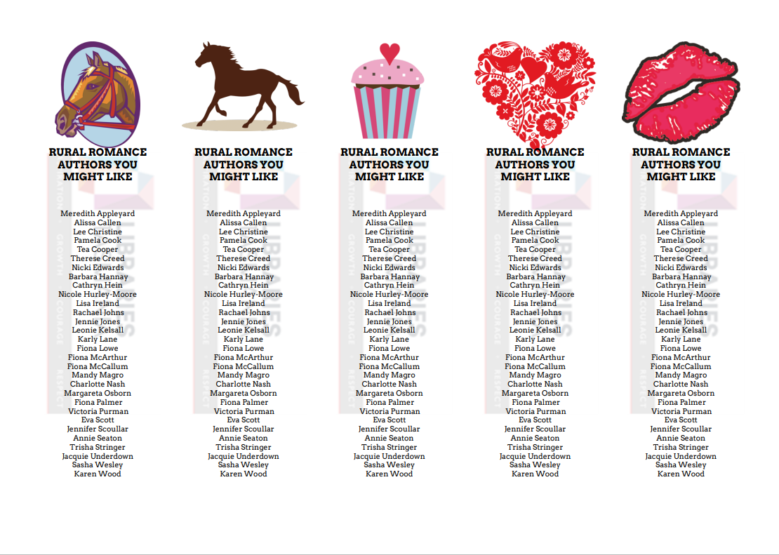
Bookmarks, Stickers and Labels
We love making bookmarks and stickers. We use Avery Print and Design Avery Design & Print Online (averyproducts.com.au) it’s free and ridiculously easy to use.
We have signed up and made our own account (this is so good: you can open a project anywhere and design) but you can just do a one off if you’d rather not sign up.
The template number that you can use to make bookmarks is 69702.

Slide 10
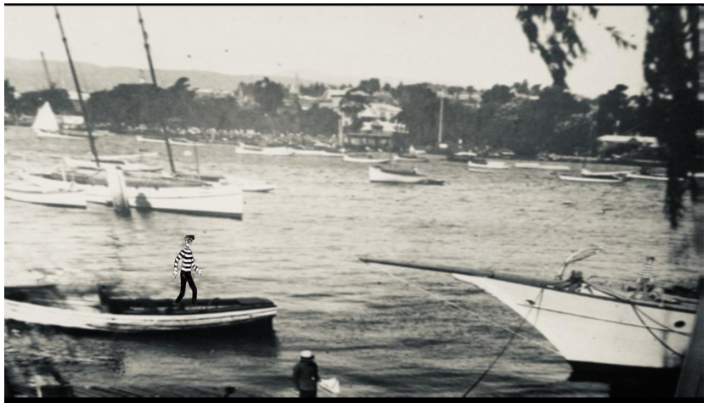
Both Wally and Odlaw are here, can you find them?

